Slide 1
Use of Explainable AI using SHAP on Crop Yield Prediction in India
Student Name: Udit Jain Roll No: 24CSM1R23 Guide Name: Dr. Manjubala Bisi

Slide 2
Scope of the Project
Project Focus
This project focuses on using SHAP to make crop yield prediction models not just accurate, but also understandable.
The goal is to ensure farmers and policymakers can trust and interpret the model’s decisions—not just see the output.
Expected Outcomes
A clearer view of which factors actually drive yield outcomes.
Tools that support smarter, data-backed planning for those working on the ground.
Ultimately, this work aims to bridge the gap between advanced AI models and real-world agricultural needs.

Slide 3
Importance of Crop Yield Prediction
Economic Impact:
Accurate predictions can enhance farmers' income and national economic stability.
Food Security: Predicting yields aids in planning for food supply, addressing hunger issues.
Resource Management: Helps optimize the use of water, fertilizers, and land, promoting sustainable practices.
Crop yield prediction is vital for India's agricultural landscape!

Slide 4
Introduction to Explainable AI
Explainable AI (XAI) refers to methods and techniques that make the output of AI systems understandable to humans.
Importance: Enhances trust and transparency in AI decisions.
Relevance in Agriculture: Critical for decision-making in crop yield prediction, ensuring farmers and stakeholders understand model outputs.
Understanding AI is essential for effective agricultural analytics!

Slide 5
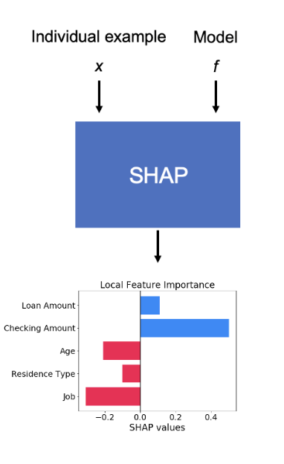
SHAP Methodology Overview
SHAP stands for SHapley Additive exPlanations.
Core Principle: Each feature's impact is calculated by comparing what the model predicts with and without that feature.
Working:
Start with a model prediction for a specific data instance.
Identify the baseline output (average prediction with no features).
Add each feature one at a time to observe its impact.
Compute SHAP values as the average marginal contribution of each feature.
Ensure additivity: all SHAP values sum up to the final prediction.
Visualize results using SHAP plots to explain feature influence.

Slide 6
Key Studies and Findings
Significant Research
Recent studies show how AI is transforming agriculture by improving forecasting and planning.
However, researchers emphasize that without explainability, the practical value of these models remains limited—especially for non-technical users.
Focus on Explainability
Research highlights that understanding AI decisions boosts both performance and adoption.
Methods like SHAP make models more transparent, helping users trust and act on predictions.
These findings form the foundation of our approach, aiming to build models that are both accurate and interpretable.

Slide 7
Problem Statement
Challenges :
Traditional AI methods often lack transparency in predictions.
Difficulty in understanding how various factors influence yield predictions.
Variability in environmental conditions.
Limited access to reliable data sources.
Understanding these challenges is crucial for effective solutions!

Slide 8
Significance of the Problem
Consequences of Inaccurate Predictions
Poor yield forecasting can cause financial setbacks for farmers due to inefficient planning.
Leads to imbalanced supply chains, triggering food shortages and market instability.
Results in wastage of resources like water, fertilizers, and labor.
Reduces farmer confidence in AI tools, slowing adoption of smart agriculture technologies.

Slide 9
Literature Survey
Most AI models in agriculture focus on accuracy, with limited attention to explainability.
Traditional models do not effectively cover the data, model, outcome, and end-user dimensions of explainability​
Title of the Paper | Published In | Significance | Limitation
Advanced ML for Regional Potato Yield Prediction | npj Sustainable Agriculture (2025) | Identifies key environmental drivers using SHAP; | Focused on one crop (potato) and region-specific
Yield Prediction for Crops by Gradient-Based Algorithms | PLOS ONE (2024) | Compares CatBoost, LightGBM, XGBoost for accurate forecasting | No XAI techniques applied or interpreted
Explainable Model for Crop Yield in Indian Conditions | IJEC (2025) | Applies SHAP for better feature insight and model trust | Limited dataset and only local interpretability
Next-gen Agriculture: AI + XAI for Precision Yield Prediction | Frontiers in Plant Science (2024) | Combines AI with SHAP/LIME under climate variability | Lacks focus on user-level explainability
Explainable ML for Corn Yield Using UAV Data | Computers and Electronics in Agriculture (2025) | Uses multispectral UAV data and SHAP for field-level yield estimation | High hardware cost; domain-limited to UAV-based data

Slide 10
Gaps in Current Research
Identifying Gaps:
Lack of interpreted models in crop yield prediction.
Need for more research integrating explainability into agricultural AI.
Importance of Addressing Gaps:
Enhancing the reliability of predictions.
Supporting farmers with actionable insights. Filling these gaps is crucial for advancing agricultural analytics!

Slide 11
Proposed Solution Overview
Integrating SHAP:
Utilizing SHAP to enhance crop yield prediction models.
Aiming for improved interpretability and accuracy.
Expected Benefits:
Better insights into the factors influencing crop yields.
Increased trust in AI-driven predictions among stakeholders. Our solution aims to revolutionize crop yield prediction!

Slide 12
Model Development Process
Stages of Development
Developed a pipeline for crop yield prediction using agricultural data.
Ensured model interpretability by planning SHAP integration early in the pipeline.
Algorithm Selection
Explored ML and DL models: Decision Tree, Random Forest, XGBoost, RNN, and LSTM.
Selection was based on performance and compatibility with SHAP explainability tools.
Final model (Random Forest) was chosen for its high accuracy (98.96%) and suitability for SHAP-based interpretation.

Slide 13
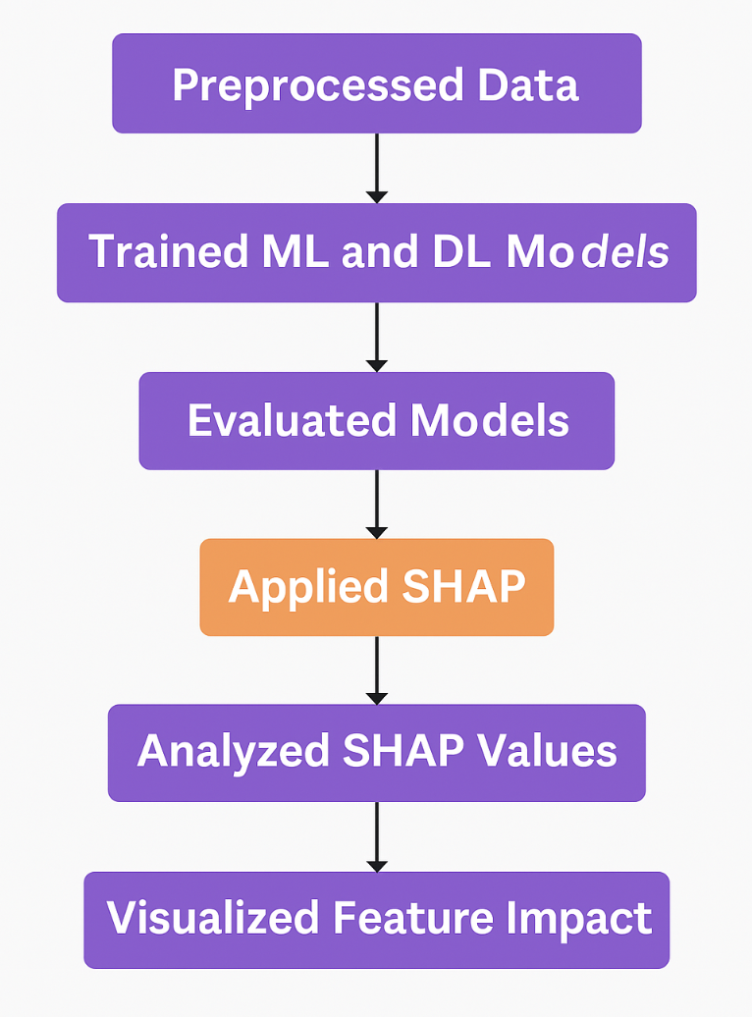
Implementation of SHAP
Workflow Steps:
Preprocessed the crop yield dataset (cleaning, encoding, and normalization).
Trained ML and DL models including Random Forest, Decision Tree, and XGBoost, RNN.
Evaluated models using metrics: Accuracy, MAE, RMSE, and SD.
Applied SHAP to the best-performing model (Random Forest) for explanation.
Analyzed SHAP values to identify key features.
Visualized feature impact using summary, waterfall, and decision plots for interpretation.

Slide 14
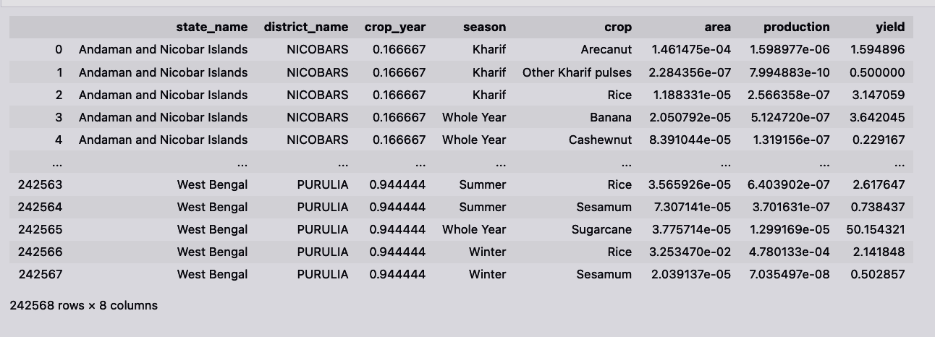
Data Collection and Methodology
Data Sources
Methodology
Utilization of agricultural datasets from government and research institutions, incorporating environmental, economic, and historical data.
The dataset includes data on multiple states and districts across India, capturing seasonal crop yield information with parameters such as:
State Name and District Name
Crop Year and Season
Crop Type, Area, Production, and Yield
Employing machine learning and deep learning algorithms alongside SHAP for analysis, ensuring robust validation of models through cross-validation techniques.
Dataset

Slide 15
Performance Metrics
Evaluation Criteria
Accuracy, MAE, and RMSE were used to evaluate model performance.
SHAP values were used to interpret model predictions and analyze feature importance.
SHAP Summary Plot highlighted key features
SHAP Waterfall Plot visualized the contribution of individual features to a single prediction
SHAP Decision Plot illustrated feature influence across multiple predictions
This approach ensured that models were not only accurate but also explainable, supporting informed decision-making in crop yield prediction.

Slide 16
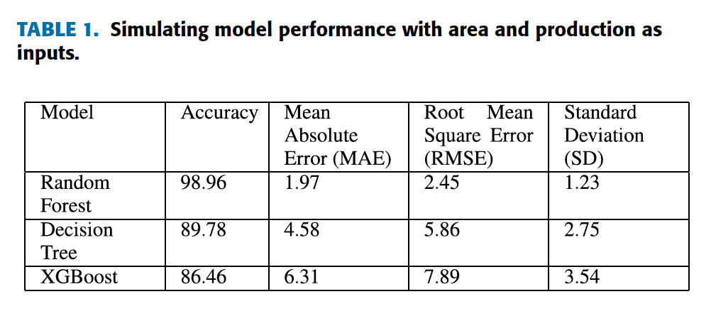
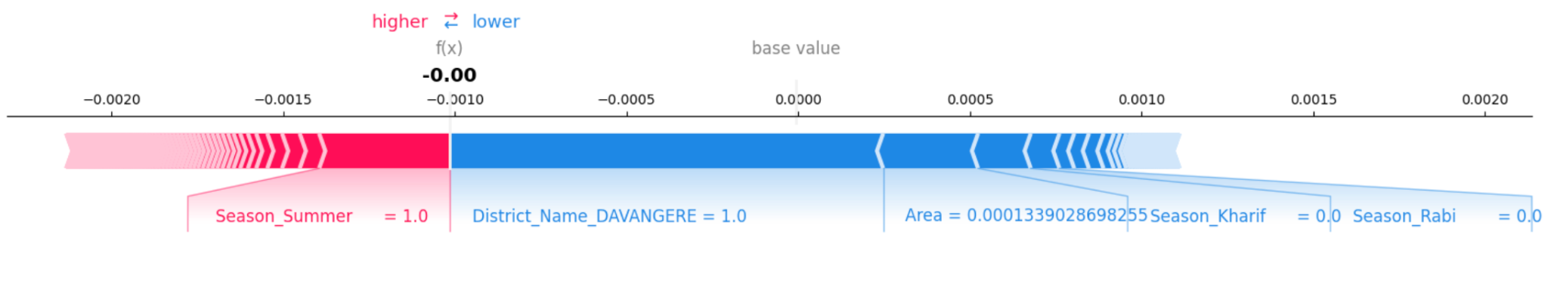
Results Overview
Force Plot
Key Results Achieved:
Achieved 98.96% accuracy using Random Forest with MAE: 1.97, RMSE: 2.45.
SHAP identified key features: Crop_Coconut, Area, Season_Kharif, Crop_Rice.
Waterfall plot showed District_TIRUNELVELI and Crop_Urad as strong positive contributors.
Decision plot illustrated consistent positive impact of Area, with variable effect from Crop_Rice.
SHAP improved model interpretability and trust, enabling informed agricultural decisions.

Slide 17
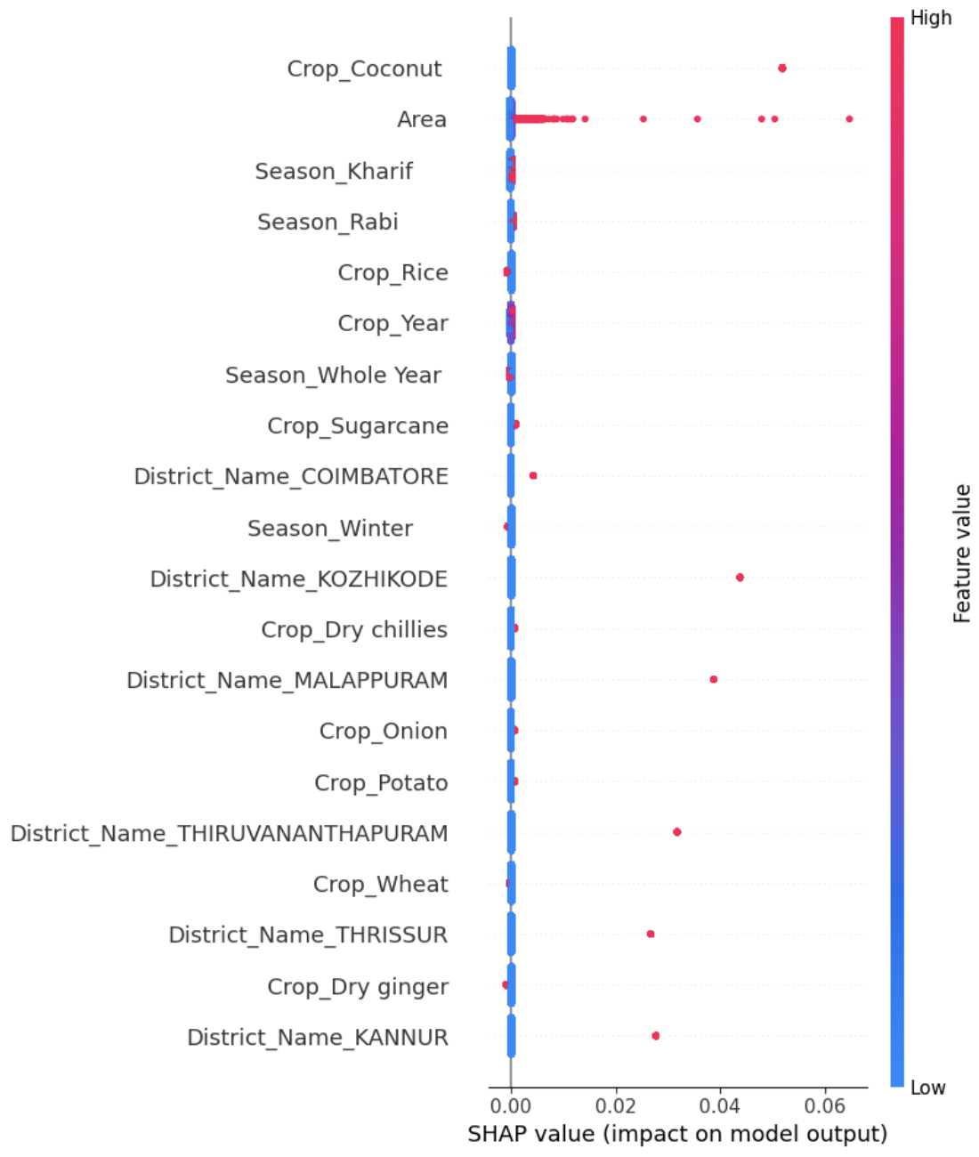
Interpretation of Results
Summary Plot
In-Depth Analysis
SHAP plots provided clear interpretability by showing:
Area had the strongest positive influence on yield.
Waterfall and force plots highlighted District_TIRUNELVELI, Crop_Urad, and Season_Kharif as key contributors to specific predictions.
Decision plot revealed consistent positive impact of Area and variable influence from Crop_Rice.
Implications of Findings
Enhanced transparency and interpretability improves trust in model outcomes.
Supports data-driven decisions for optimizing crop planning and resource allocation.
Insights can guide region-specific policies by identifying high-impact crops and conditions.

Slide 18
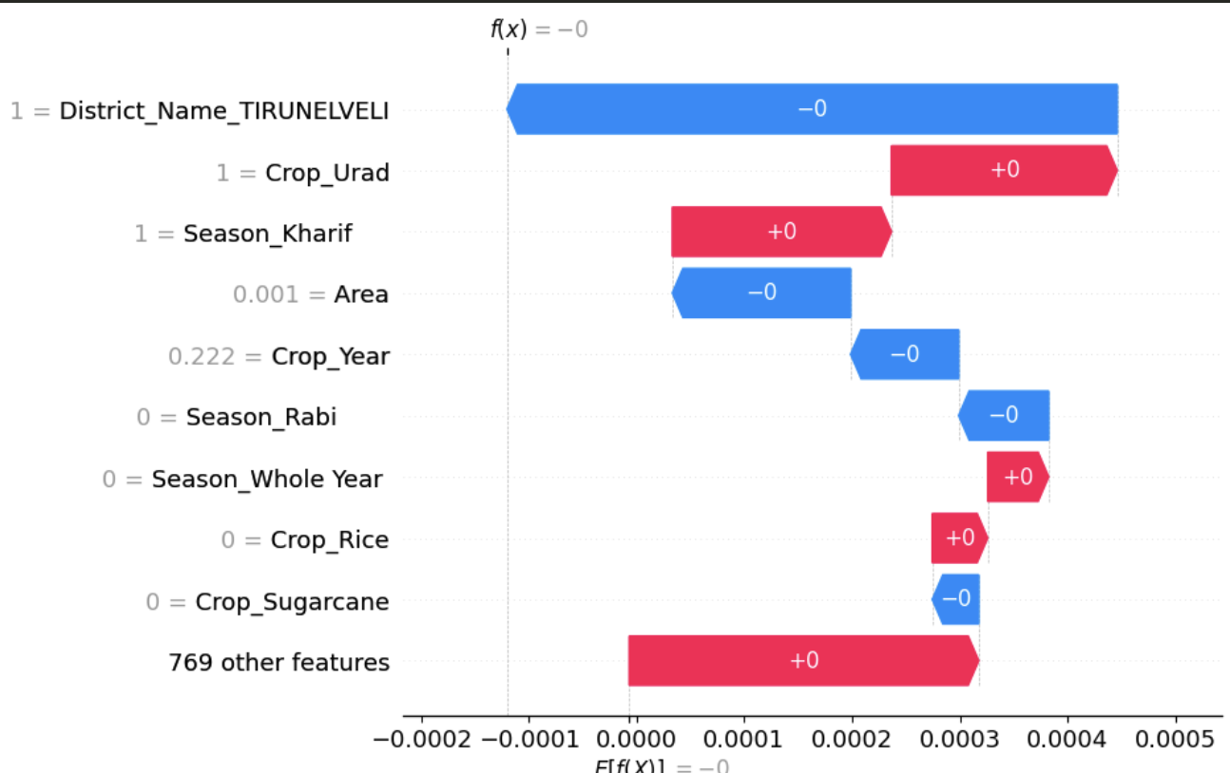
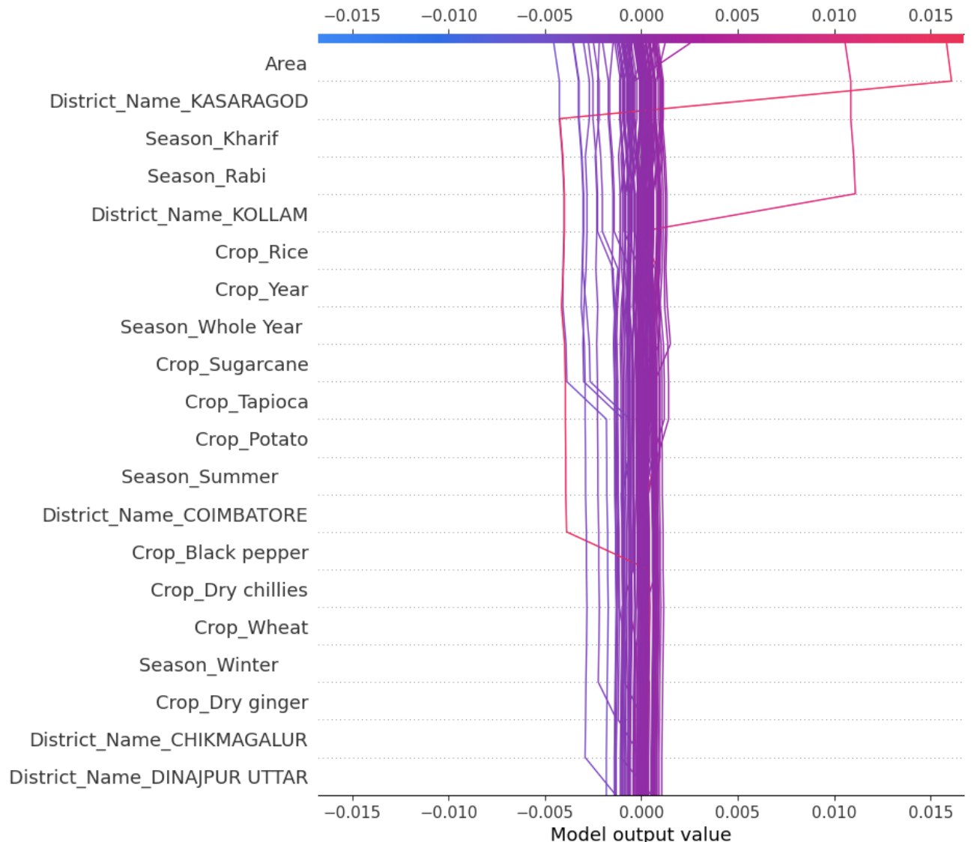
Visualizing SHAP Values
SHAP Value Representations
Waterfall plot breaks down individual predictions feature by feature.
District_Name_TIRUNELVELI, and Area had strong positive contributions.
Features like Season_Kharif and Crop_Urad showed negative influence.
Decision plot shows cumulative effect of features over multiple samples.
Crop_Rice and District_Name_KASARAGOD consistently increased predicted yields.
Waterfall Plot
Decision Plot

Slide 19
Comparison with Traditional Models
Performance Comparison
Random Forest + SHAP achieved 98.96% accuracy
Outperformed:
Decision Tree: 89.78%
XGBoost: 86.46%
Lowest MAE (1.97) and RMSE (2.45) among all models
Evaluating SHAP-enhanced models against traditional predictive models highlights improvements in interpretability.
Key Takeaways
SHAP provide clear interpretability through feature contribution visualization
Enable greater user trust and informed decision-making in agriculture

Slide 20
Conclusion and Insights
Project Summary
Demonstrated how integrating Explainable AI with SHAP enhances both prediction quality and understanding.
Enabled stakeholders to not just see predictions, but also understand the why behind them.
Combined high model accuracy with interpretability, bridging the gap between AI performance and usability in agriculture.
Future Implications
Opens new directions for decision-support systems tailored to farmers and policymakers.
Lays the groundwork for scalable AI frameworks that can adapt across crops and regions.
Reinforces the importance of trustworthy AI in critical domains like food security and sustainability.

Slide 21
Thank You

